Slide 1
IDENTITY THEFT
PATRICIO ECHEVERRIA
SANTIAGO ROQUE

Slide 2
DO YOU KNOW WHAT IS IDENTITY THEFT?
There were 14 answers

Slide 3
IDENTITY THEFT IS……
There were 14 answers

Slide 4
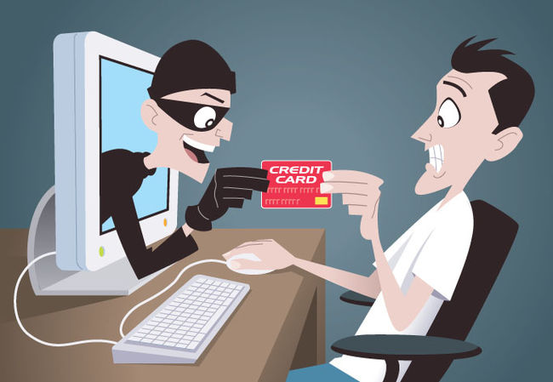
Identity theft is a crime in which an imposter obtains personal information, like social security or driver’s license numbers. They can create a profile with your information in social media and pretend to be you.

Slide 5

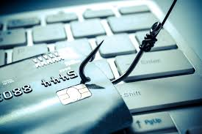
How does it affect you?
They take your information and it can be used to obtain credit, merchandise and services with your name. And it also affects you because they can use the things you post and create and new account pretending to be you and do bad things.

Slide 6
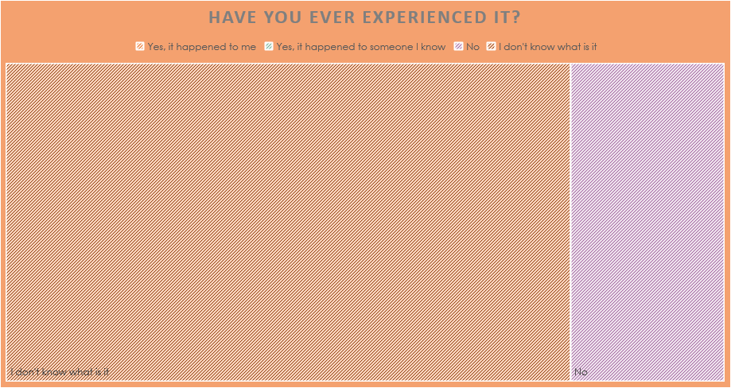
Have you ever experienced it?

Slide 7
How can you avoid it?
Lock your credit
Use strong passwords
Don’t share personal information
Take care shopping online
Stay alert

Slide 8
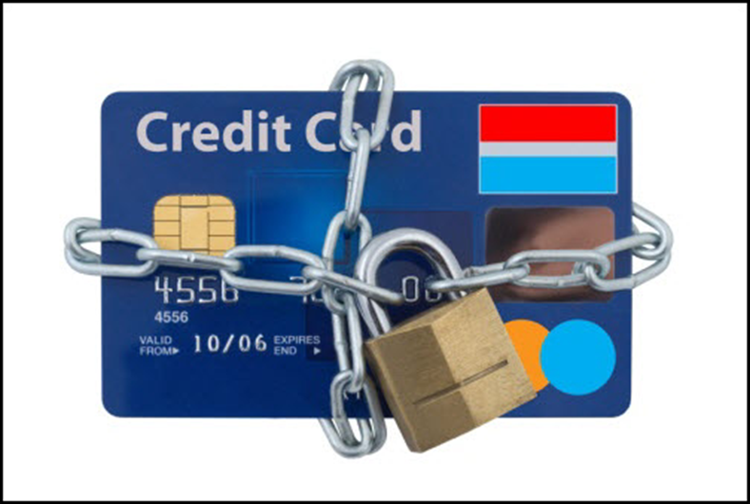
References
“Identity Theft”. SearchSecurity https://searchsecurity.techtarget.com/definition/identity-theft
(4/10/18)
“How to Prevent Identity Theft”. WikiHow https://www.wikihow.com/Prevent-Identity-Theft
(4/10/18)
“How identity theft affects you” Defend
http://www.idefendfamily.com/how_id_theft_affects_you.aspx
(29/10/18)

